Slide 1
More Place Value, Addition, Subtraction
Use place value to add, subtract and round 6- and 7-digit numbers
Objectives
Day 1
Understand what each digit represents in 7-digit numbers. Compare numbers up to 10 million.

Slide 2


Day 1: Understand what each digit represents in 7-digit numbers; Compare numbers up to 10 million.
Commas or thin spaces (in print) are used to group digits in groups of three to help us to read big numbers.
We will use commas to do this.
4,351,468
Let’s read the part of the number that we can see: four hundred and sixty-eight
This digit tells us how many millions there are. Read the whole number: four million, three hundred and fifty-one thousand, four hundred and sixty-eight.
These digits tell us how many 1000s there are. Three hundred and fifty-one thousand, four hundred and sixty-eight.
Count on in 1s to write the next three numbers on your whiteboards:
4,351,469 4,351,470 4,351,471
Practise reading them out aloud.

Slide 3
Day 1: Understand what each digit represents in 7-digit numbers; Compare numbers up to 10 million.
2,743,561
Now read the last three digits, and then read the thousands, then the whole number.
What is 2,743,561 – 40,000? Which digit will change?
Now subtract 500.
What are we left with?
Now subtract 700,000.
What are we left with?
Now subtract 3001.
What are we left with?
2,000,060
two million and sixty

Slide 4
Day 1: Understand what each digit represents in 7-digit numbers; Compare numbers up to 10 million.
☐,☐☐☐,☐☐☐ > ☐,☐☐☐,☐☐☐
You are to going try to make the first number greater than the second number.
Where should we place the first digit rolled?
Roll a 0–9 dice.
Repeat until all the spaces are filled.
Write the biggest number possible using the seven digits on the left.
Write the smallest number possible using the seven digits on the right.
Now write a number in between these two 7-digit numbers.

Slide 5
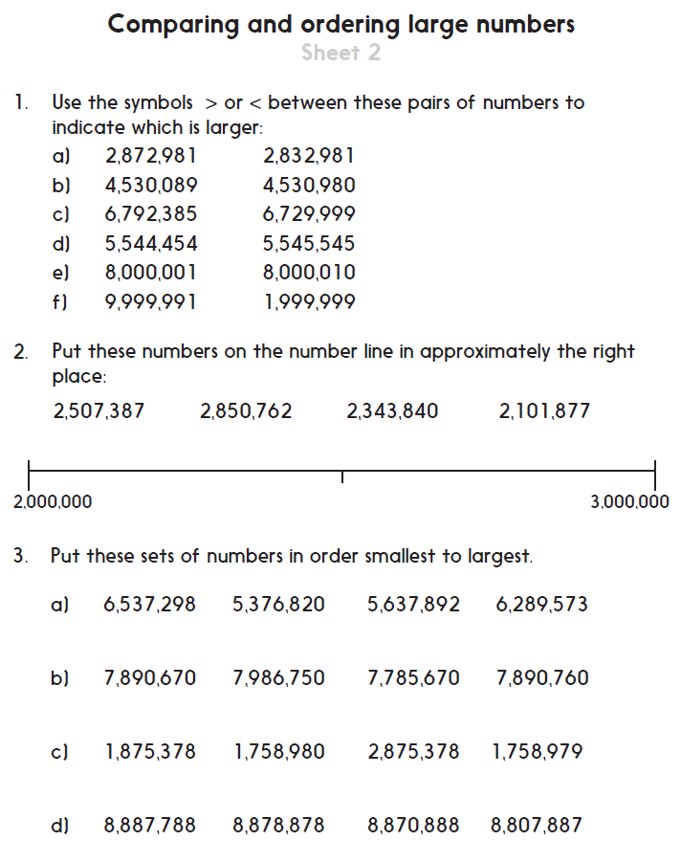
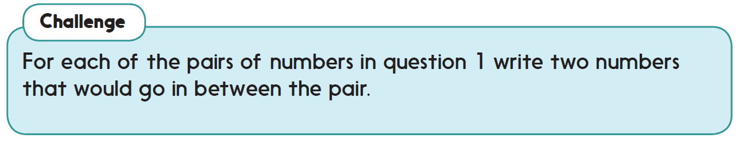

Challenge
Complete sheet 1 and/ or 2 with
this heading.
They are saved as activity sheets
Wed and Thur.

