Slide 1
REMEMBERING OUR HEROES
Made by the vice captains of 2021

Slide 2
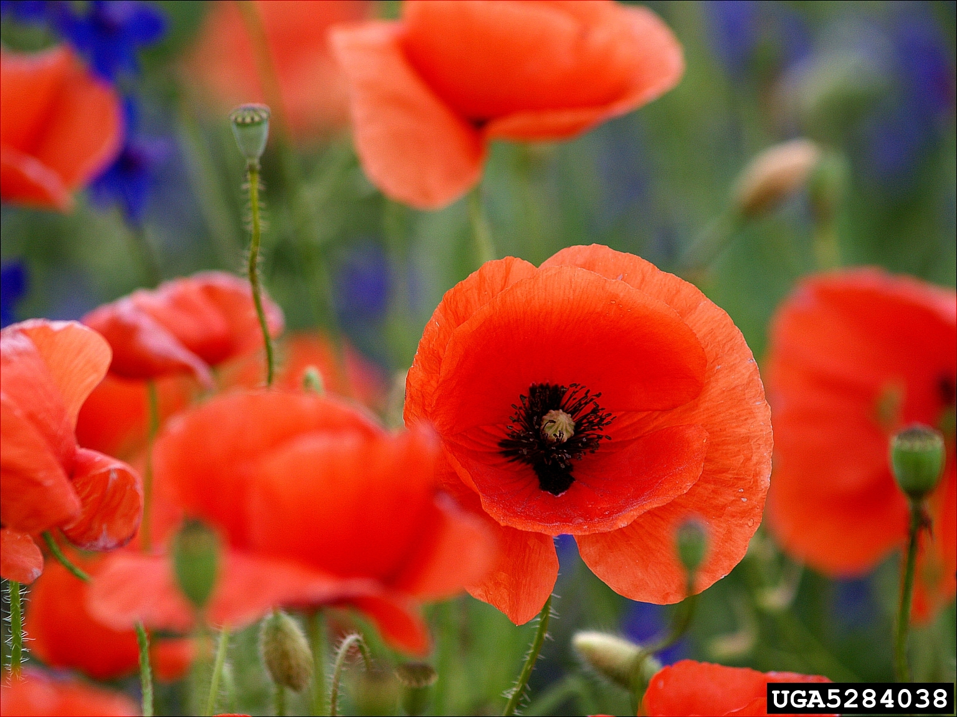
We wear poppies in remembrance of all of the soldiers that stood up for our amazing country in the war! In remembrance of our heroes, the battlefield is covered in beautiful red poppies.
We wear poppies as a sign we are thinking of all those lost in the world wars.
The poppies are sold as part of the poppy appeal that raises money for the Royal British Legion, an organisation that helps those impacted by conflicts and all the service men and women and their families who are still alive today and lives were changed by war.

Slide 3
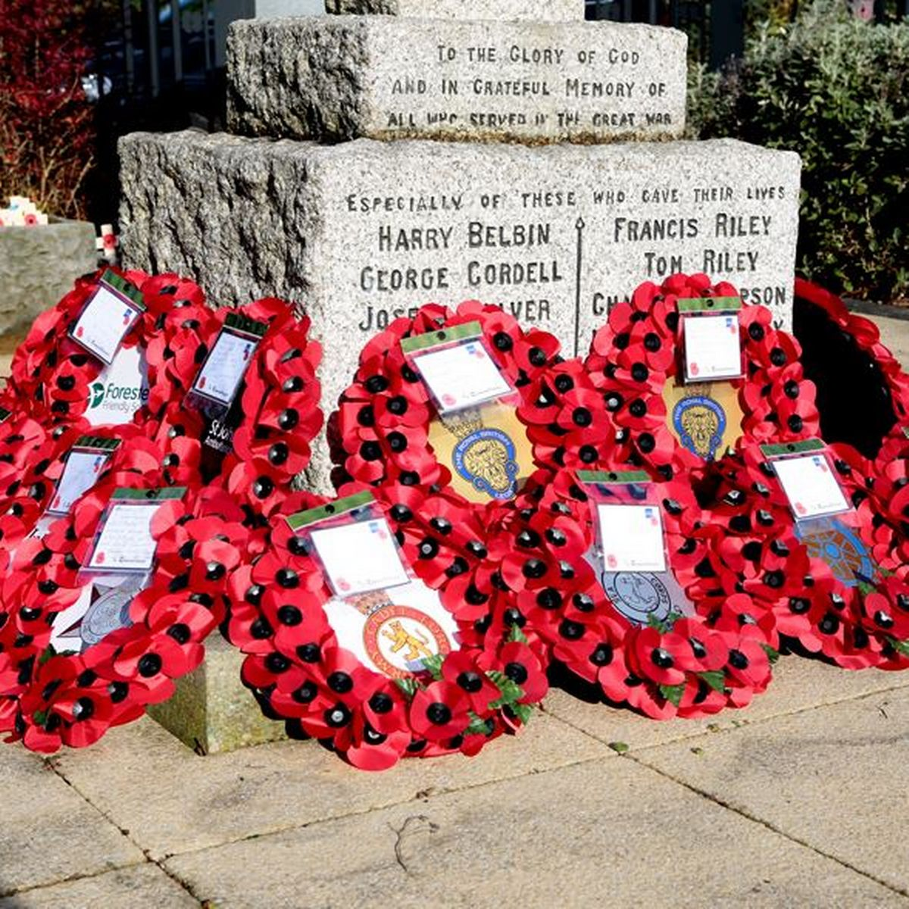
Laying wreaths at war memorials is a key part of remembrance services. The laying of wreaths allows individuals and organisations to pay their respects and lay tribute to individuals or groups.
Remembrance Sunday is held in the United Kingdom as a day to reflect on the contribution of British and Commonwealth citizens in two world wars and later conflicts. Local mayors of towns and villages also lay wreaths at War Memorials throughout the country.

Slide 4
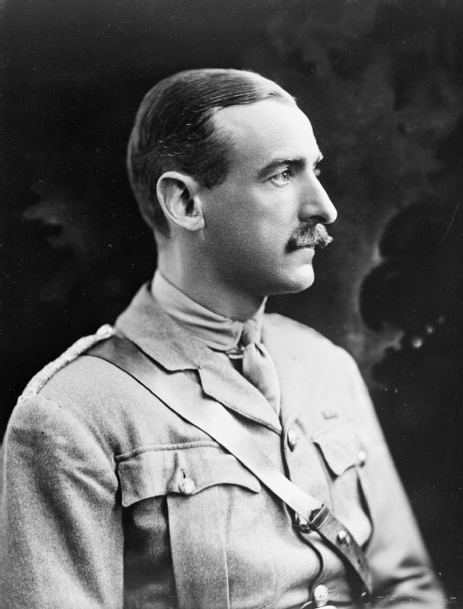
Many people sacrificed a great deal of their lives for generations to come.
One example is Adrian Carton (a Belgian-Born British army officer) who suffered many injuries and survived several plane crashes. Despite all these injuries, he remained fully dedicated to the military service.

Slide 5
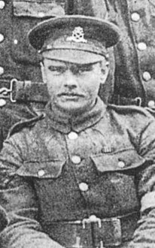
The Weaponless Warrior
William Coltman was born in Rangemore in January 1915. When he was 24 years old he joined the British Army. Near the start of world war one, William went to serve in France but after being trapped one night in a bunker listening to the cries of wounded and dying men around him he promised never to fire a shot in anger and became a ‘stretcher bearer’.
Stretcher bearers had to run into danger to carry wounded men out and provide first aid. They also had to keep the patients’ spirits up. William received many awards for his unselfish bravery.

Slide 6
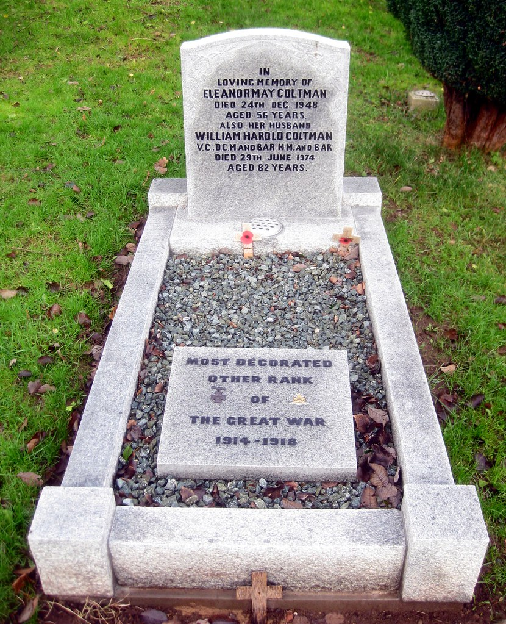
He earned the Victoria Cross in 1918 for returning, on his own, into a battlefield from where his own side had retreated. He did this to save wounded soldiers that had been left behind. He completed this over 3 days without rest, until he finally collapsed of exhaustion.
When William received his Victoria cross medal from King George at Buckingham Palace, he travelled home by train. He had heard that there was to be a ‘Welcome Home Party’ at Burton Train Station to honour him so he got off a stop earlier to “avoid the fuss”.
William Coltman’s extraordinary bravery throughout the war had a huge impact on the people around him.

Slide 7
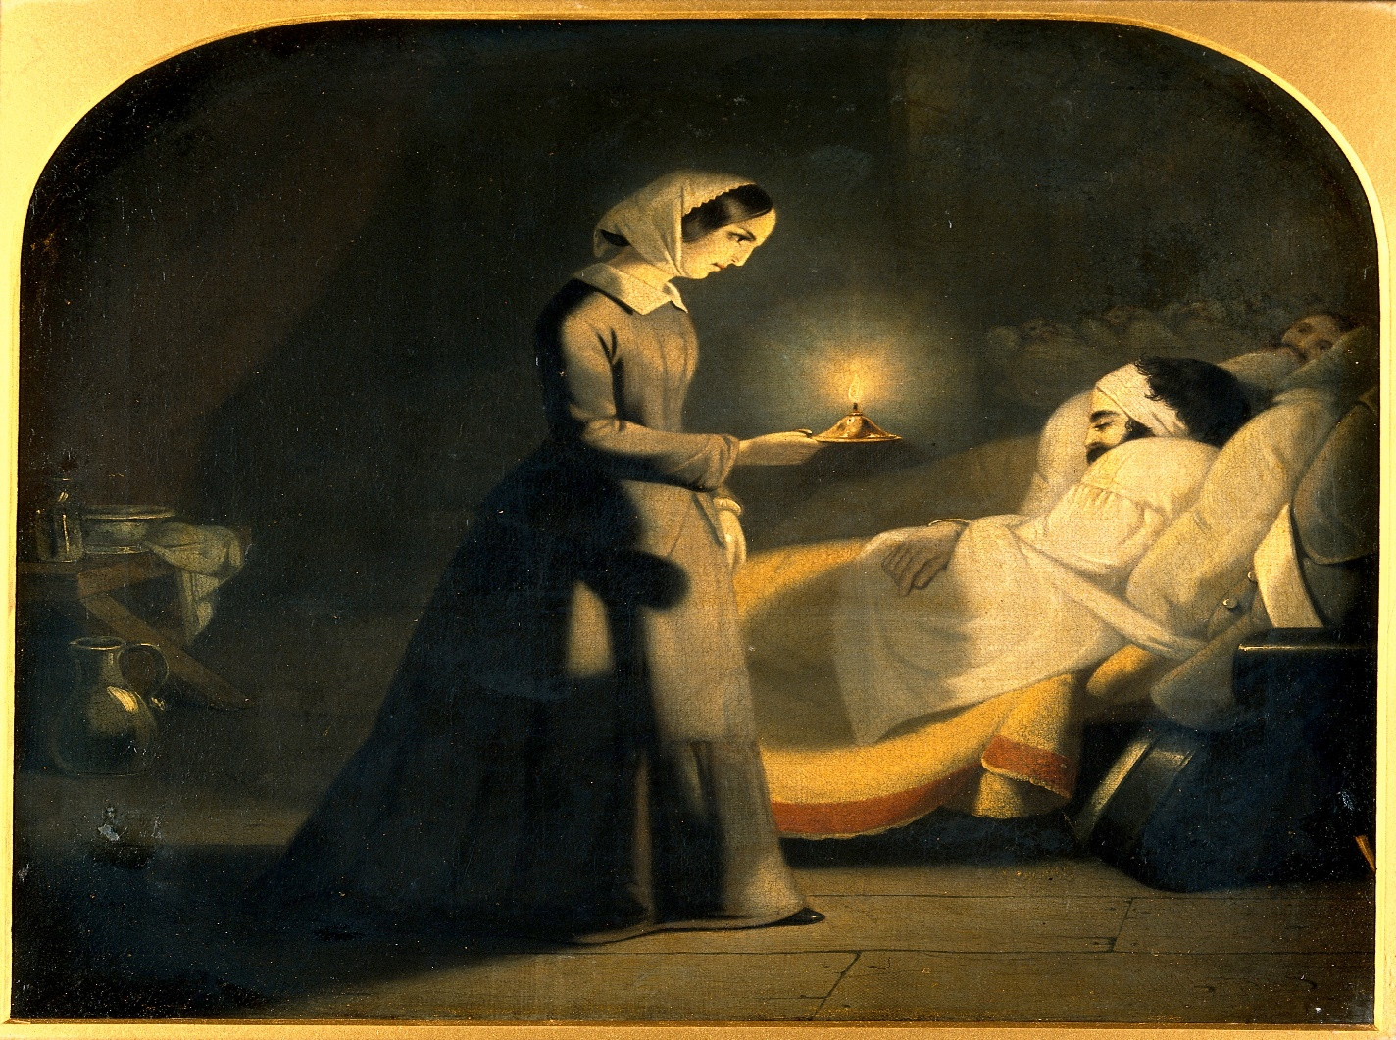
Florence Nightingale was born on the 12th of May 1820 and she died on the 13th August 1910. The awards she got were the Royal Red Cross and Order of Merit.
Florence Nightingale was a social reformer and the founder of modern nursing. Florence was also known as the ‘Lady with the lamp’ because she used to go round the war hospital greeting and comforting the patients.

Slide 8
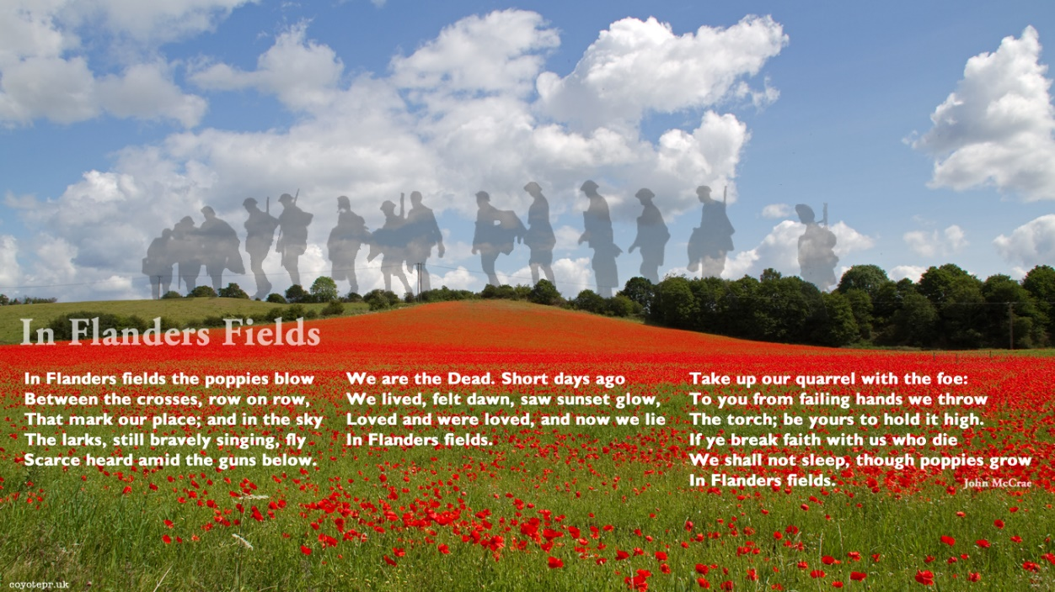

Slide 9
Thank you very much for listening to our slides and all of the money we have raised by selling poppies! At 11 o’clock, we would like everyone to take a 2 minute silence thank you.
LEST WE FORGET

