Slide 1

Y6 INFORMATION EVENING
Monday 23rd September 2024

Slide 2

Workshop Aims
To inform parents/carers about the Y6 learning journey, including key dates and events.
To share end of KS2 academic expectations in reading, writing, SPAG, Maths and Science.
To explain what SATs week involves, how we prepare and the emphasis on pupil wellbeing.
To identify how you can best support your child at home.
To explain high school transition processes
To answer any questions you may have!

Slide 3

Year 6 National Curriculum
The move into Y6 can be daunting – but it really doesn’t have to be! Being in Y6 truly is the most memorable time in your child’s primary education.
What will my child do in Year 6?
As in all other year groups, Year 6 follows statutory schemes of learning set down by the government. Children are assessed at the end of the year as to whether they have met the ‘expected’ national standard.
1. Key Stage 2 SATs - at the end of the year, pupils complete SATs (standardised assessment tests) to determine whether they have met the ‘expected’ level in English and Maths.
2. A broad and balanced curriculum – children continue to study a wide range of subjects, which are equally as important. In Y6 History, children study the Vikings and World War 2. Science topics include electricity, evolution and inheritance, the circulatory system, classification and light.
3. Moving on up - a big part of Y6 is preparing and being ready both academically and emotionally for the move up to high school.

Slide 4

Standard Assessment Tests
KS2 SATs (National Curriculum Tests) are tests children take at the end of Year 6. SATs test children on what they have learnt between Y3-6.
KS2 SATs are mandatory tests from the National Curriculum assessment programme. All state schools in England are required to sit the tests.
They are marked externally and the results sent to schools.

Slide 5
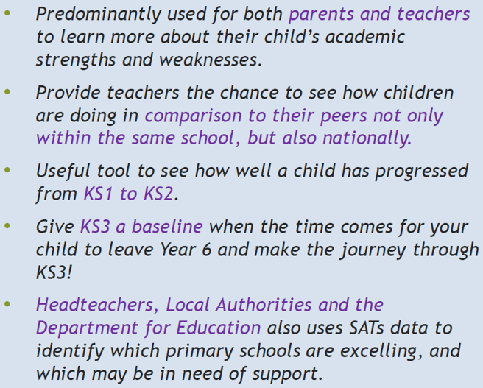
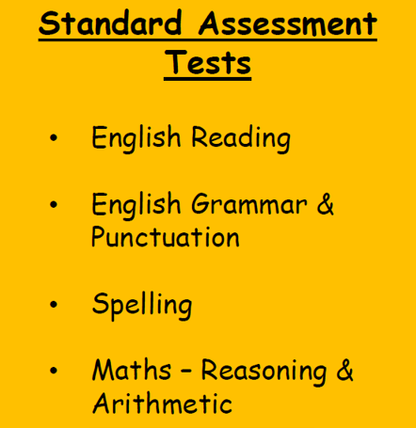
SATs – what and why?

Slide 6

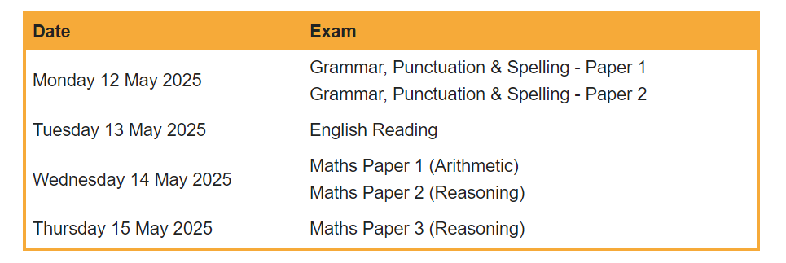
SATs Timetable 2024

Slide 7
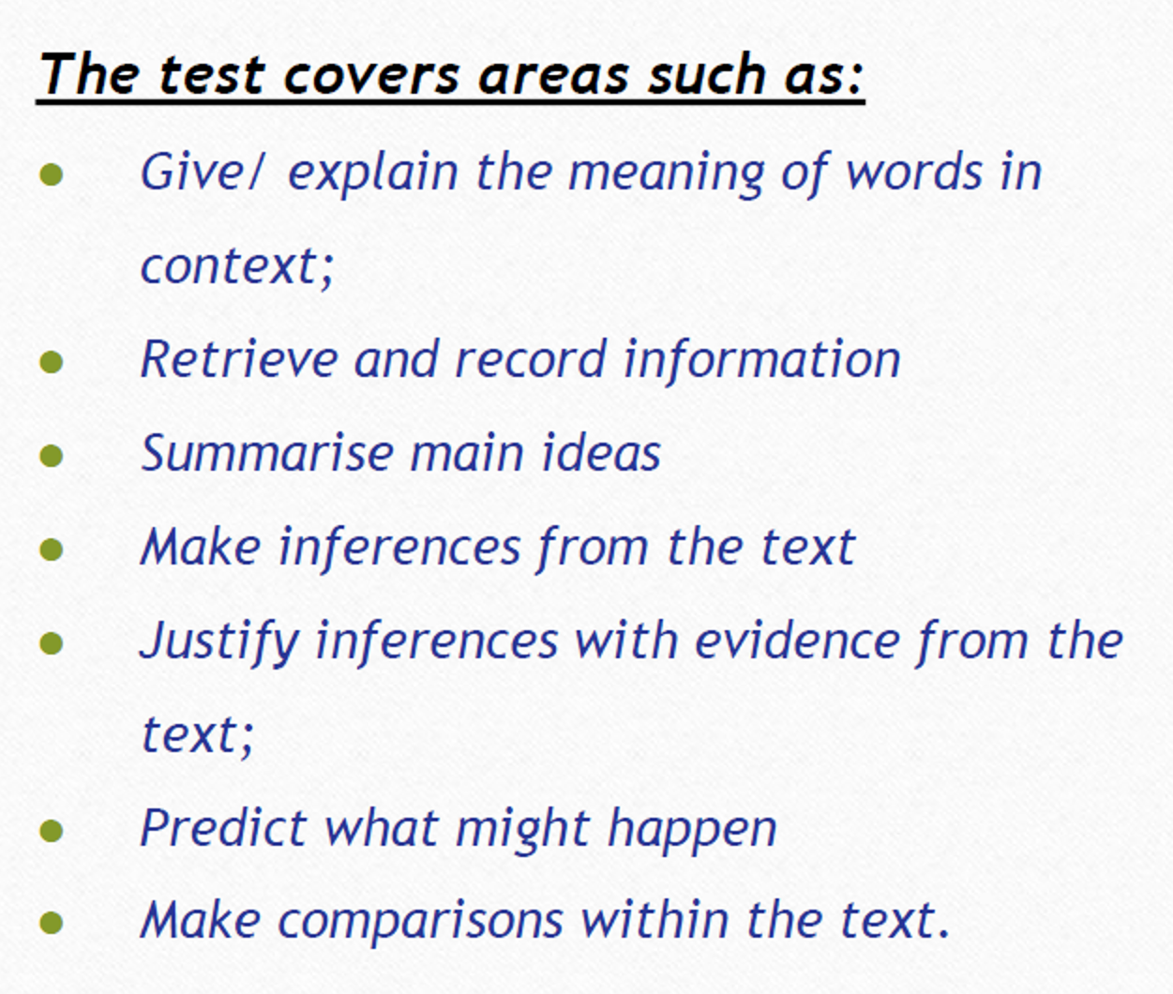
SATs - Reading Paper
There is one reading paper which lasts for 60 mins
The test is designed to measure if the children’s reading of age-appropriate texts meets the national standard
There are three set texts for children to read
These could be any combination of fiction, non-fiction or poetry.

Slide 8
Reading questions
The reading SATs paper asks different types of questions which require a range of answer styles. Since this format of SATs began (2016), three main types of questions are predominant – try to practise these when reading at home.
In the 2024 Reading SATs paper:
38% of marks could be gained from answering questions involving retrieving and recording information or identifying key details from a text;
44% of marks could be gained from answering questions involving making inferences from a text and justifying inferences with text evidence;
10% of marks could be gained from answering questions involving giving and explaining the meaning of words in context.

Slide 9
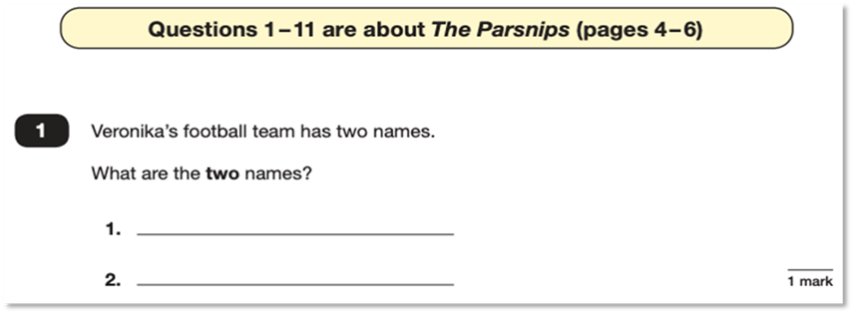
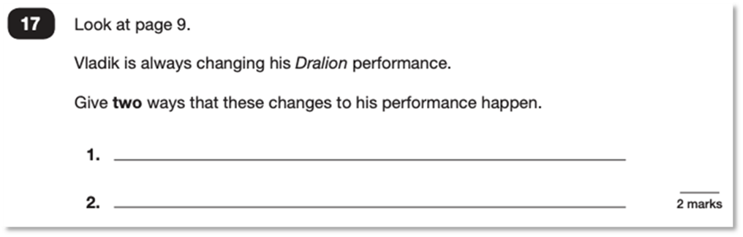
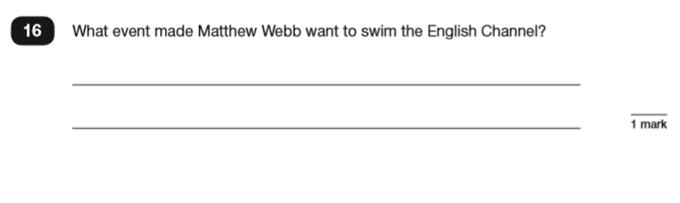
Retrieval questions

Slide 10
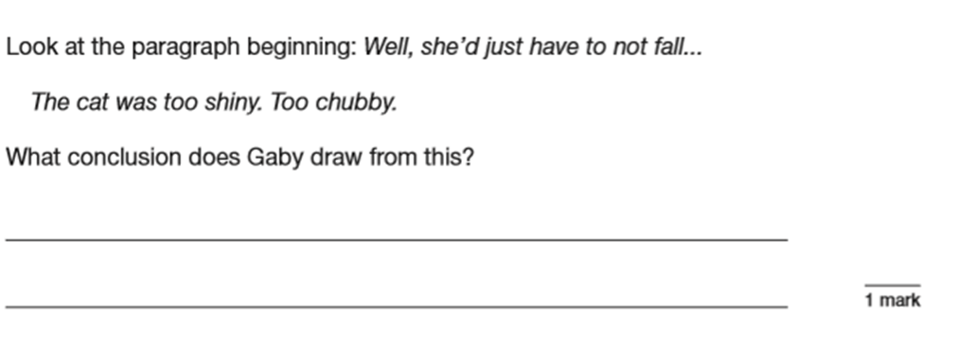
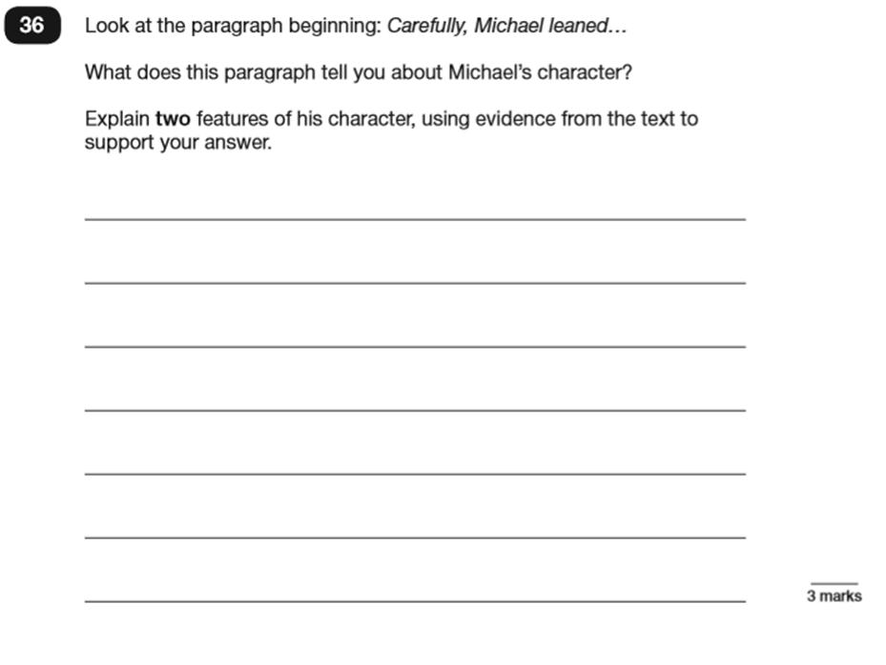
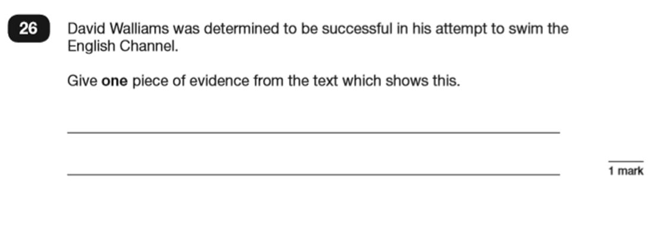
Inference questions

Slide 11
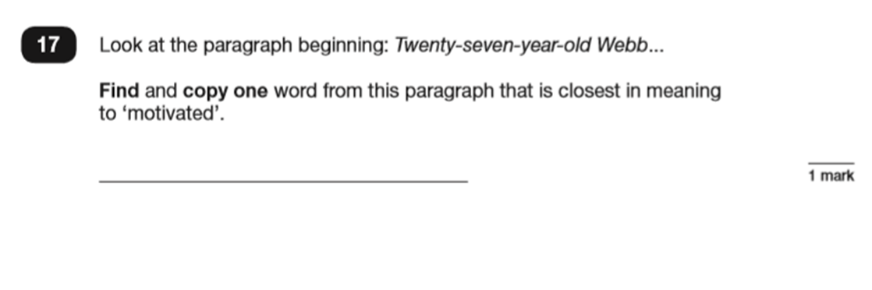
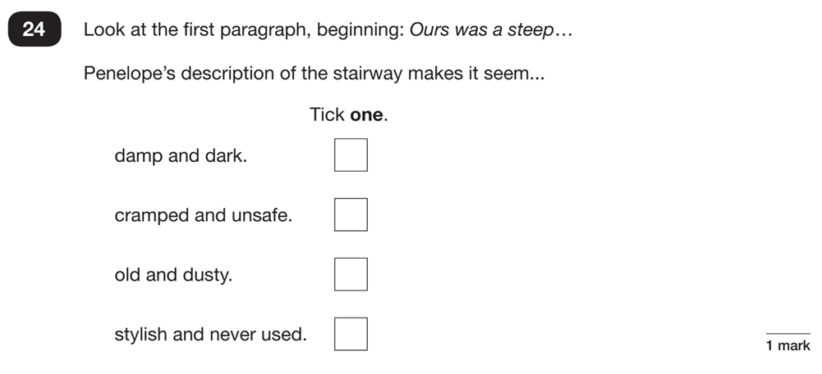
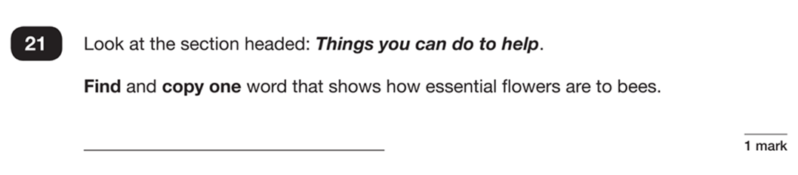
Vocabulary questions

Slide 12

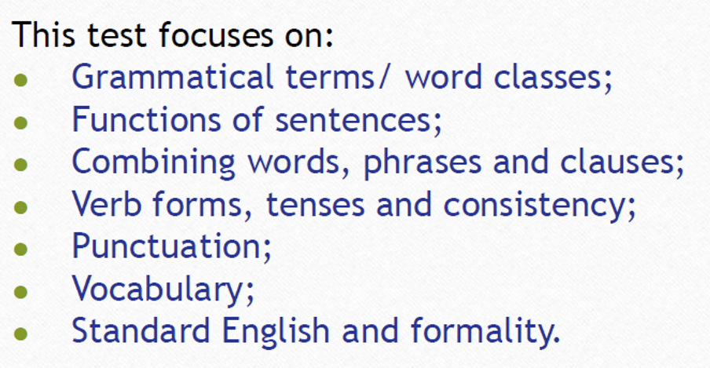
SATs - GPS Paper
This consists of two papers – one Grammar and Punctuation paper (45 minutes) and one Spelling paper, lasting approximately 20 minutes (no specific time limit)
The grammatical knowledge and terminology required has been developed, secured and regularly revised over the last 4 years
Short answer questions only – range of question styles.

Slide 13
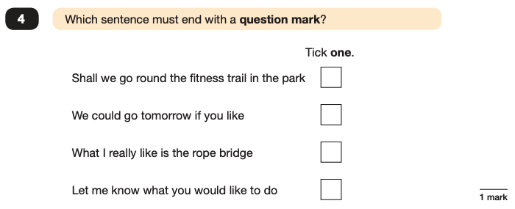
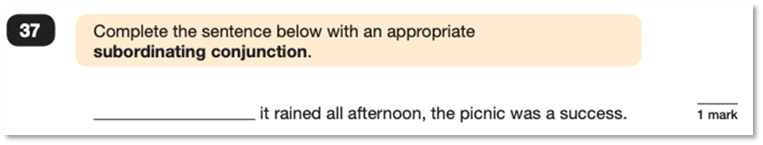

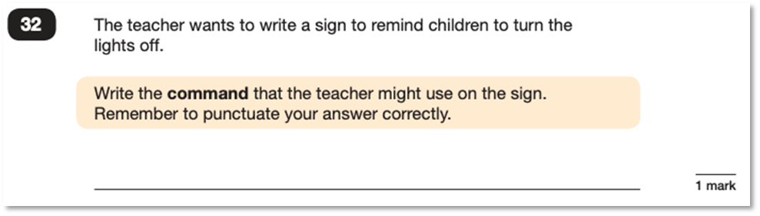
GPS question types
✓
e.g. Although, While
e.g. Switch off the lights! Please turn off the lights.

Slide 14

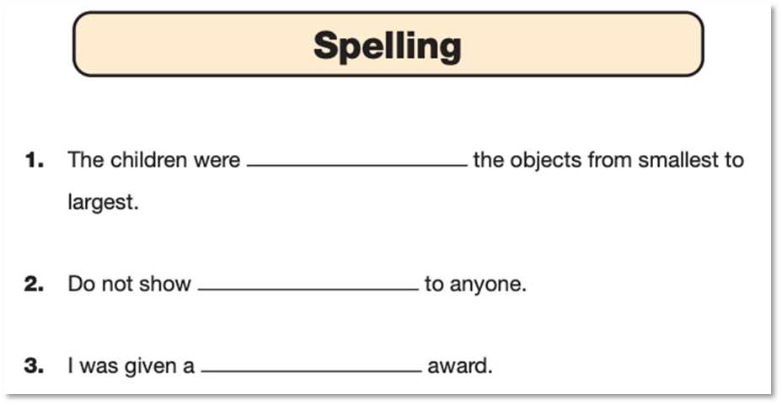
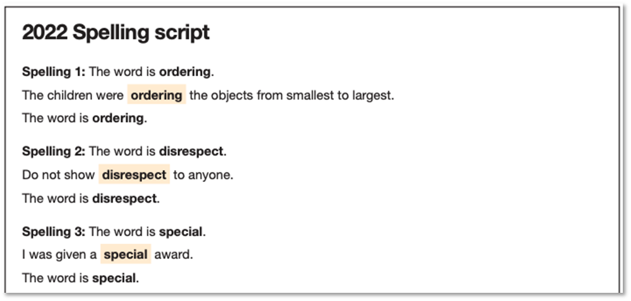

Spelling Paper

Slide 15

Maths Paper
Comprises 3 tests:
Paper 1 Arithmetic (30 minutes)
Calculation based with a focus on number, operations, fractions and percentages.
Papers 2 and 3 Reasoning (40 minutes each)
Context based, word problems or questions which require a deeper level of understanding than just procedure. Covers number (often money), geometry, coordinates, fractions, decimals, percentages, angles and algebra.

Slide 16
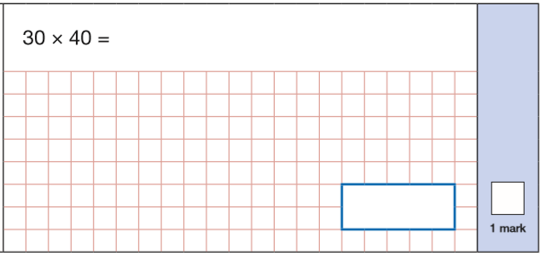
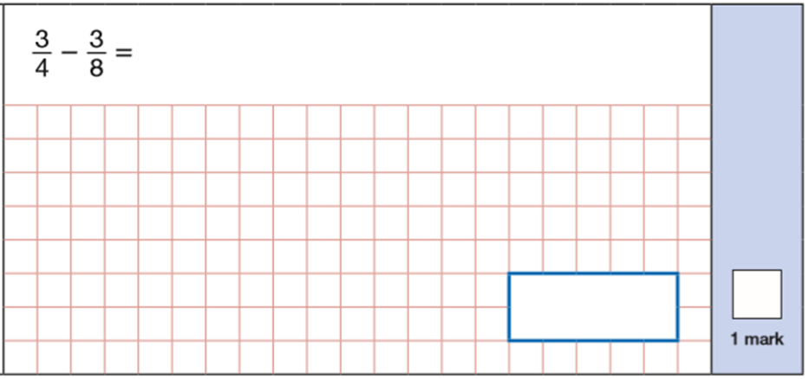
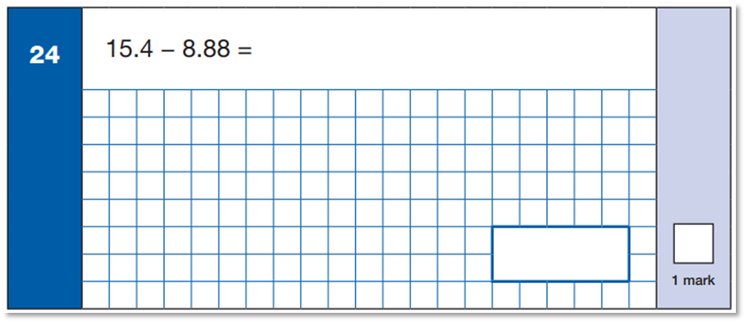
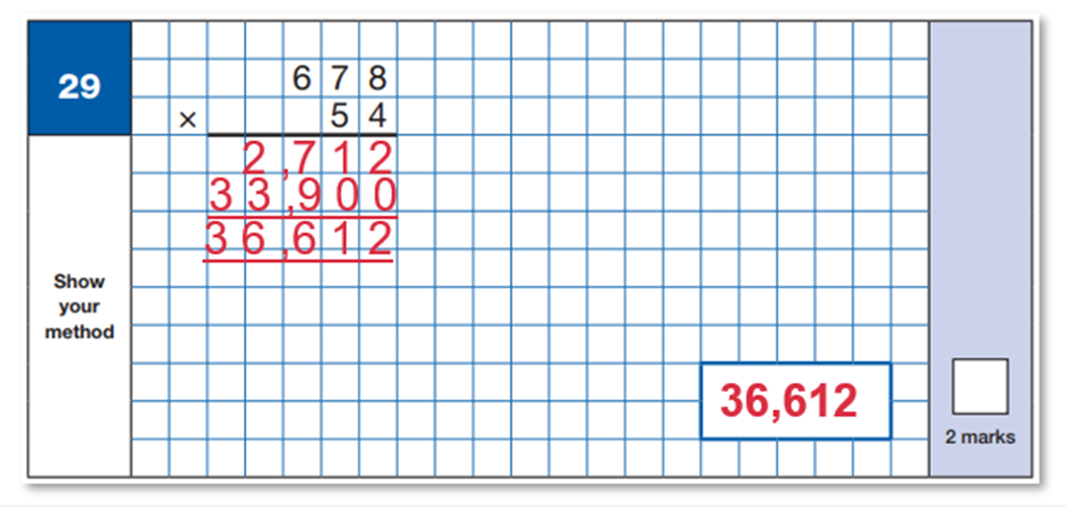
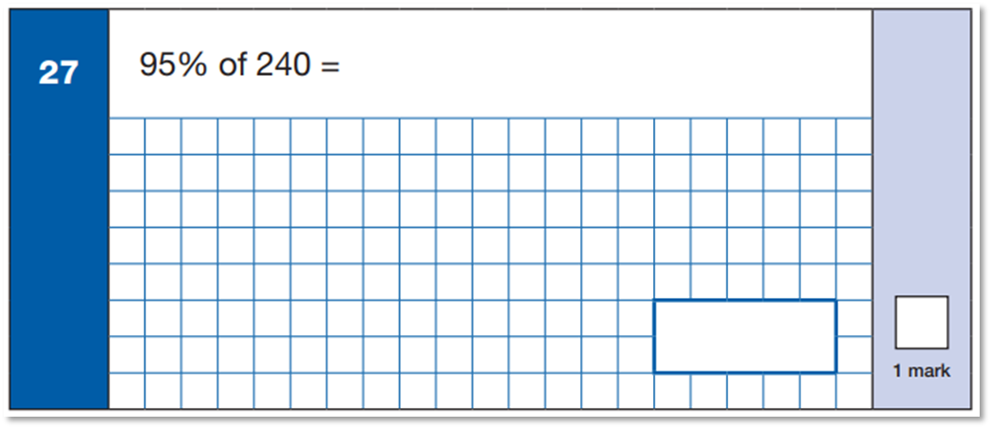
Notes:
Maths Paper 1 (Arithmetic) has a standard timing of 30 minutes and is worth a total of 40 marks across 36 questions.
It covers the four operations (addition, subtraction, division, multiplication) – many of them requiring mental calculation only. They don’t even have 1 minute per question so drawing on their mental calculation as the most efficient method is so important.

Slide 17
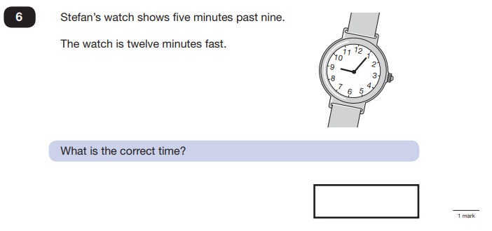
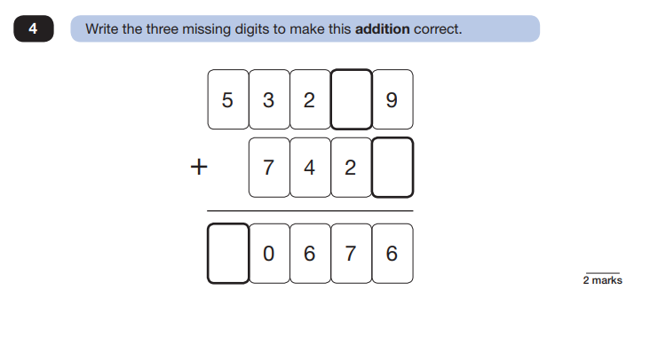
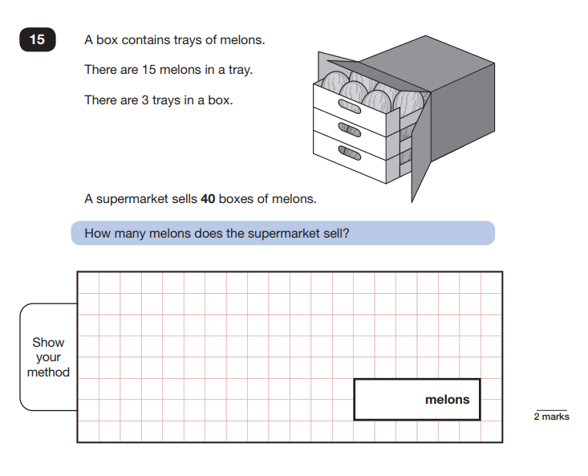
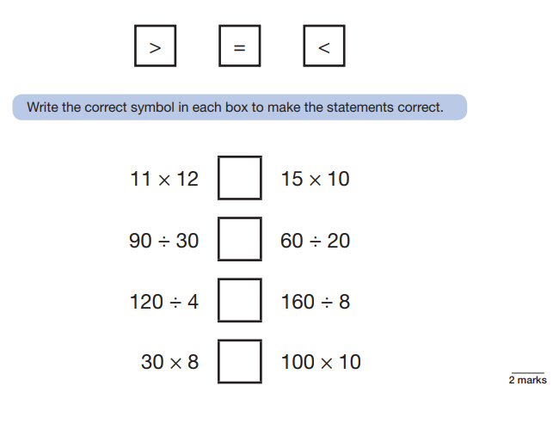
Notes:
Maths Paper 2 (Reasoning) will take place on Wednesday.
Maths Paper 3 (Reasoning) is scheduled for Thursday.
Both have standard timings of 40 minutes and are worth 35 marks each.
These papers require children to demonstrate their mathematical knowledge and skills, as well as their ability to solve problems and their mathematical reasoning.
Questions focus on the following Mathematical topic areas:
- Number and place value– including Roman Numerals;
- Addition, subtraction, multiplication and division (calculations);
- Geometry – properties of shapes;
- Geometry – position and direction;
- Statistics;
- Measurement – including length, perimeter, mass (weight), volume, time and money;
- Algebra;
- Ratio and proportion;
- Fractions, decimals and percentages.

Slide 18
How are we preparing?
Continual process over the last 4 years - building curriculum knowledge, skills and SATs style assessment practice
Small class sizes for core subjects
Revision sessions and targeted learning to ‘plug gaps’ embedded into daily learning
Additional support sessions and intervention, as required
Time/anxiety management tips and test technique
Weekly homework tasks
SATs revision packs for home use
At the forefront of what we do at TRJS:
Relaxing pupils – mindfulness and wellbeing training
Not putting a huge emphasis on SATs in school and lessons
Social SATs week breakfasts

Slide 19

Additional support
School can apply for special arrangements such as additional time, if beneficial to pupils.
However, there are strict criteria to be met to qualify for this.
Adult support with question reading in the GPS and Maths papers is allowed – this is usual practice in school.

Slide 20
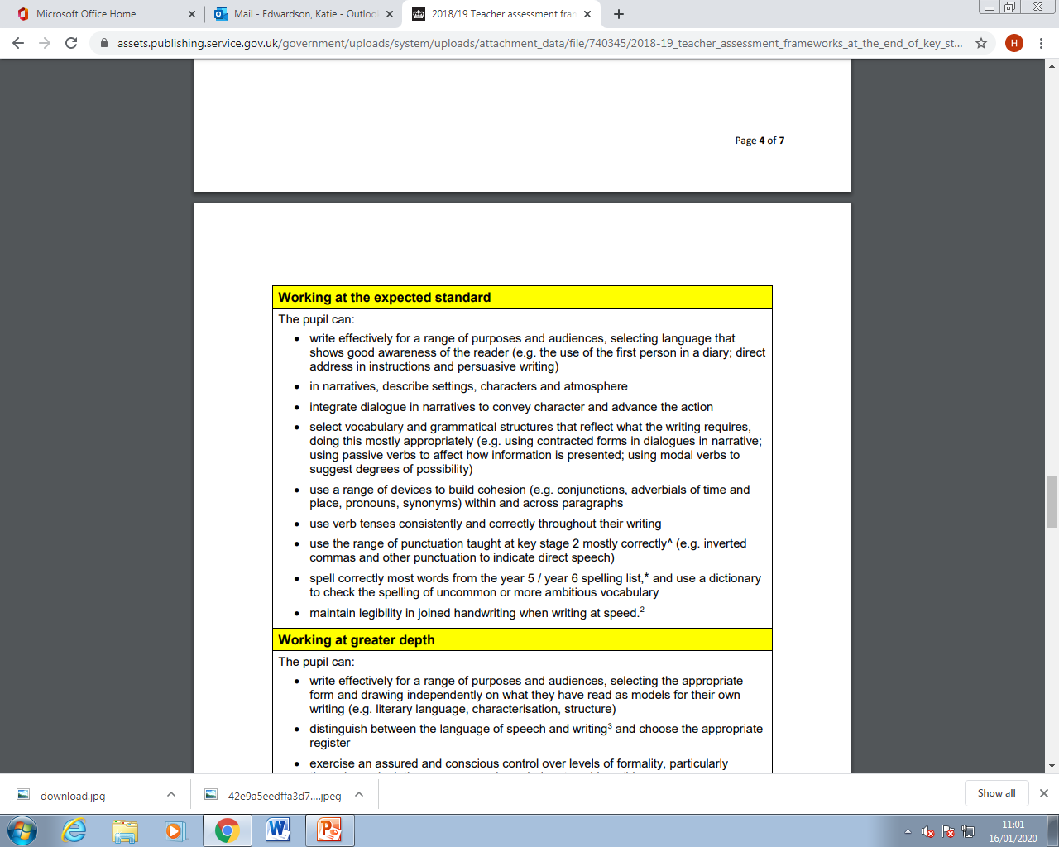


Y6 Writing Expectations

Slide 21
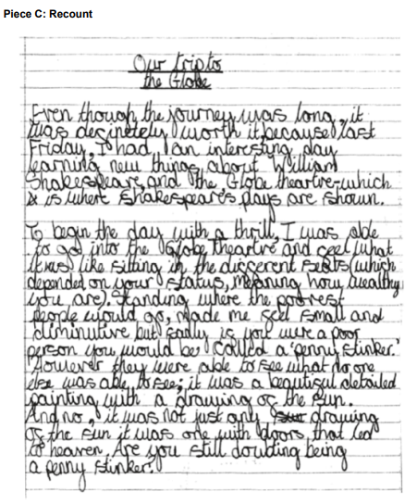
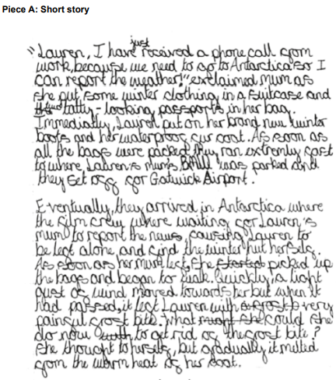
Expected Standard

Slide 22


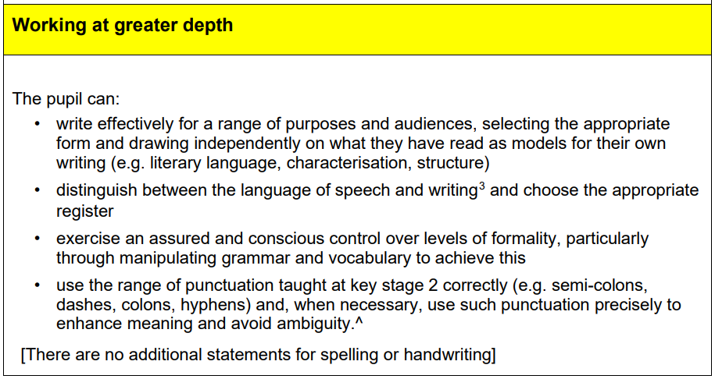



Slide 23
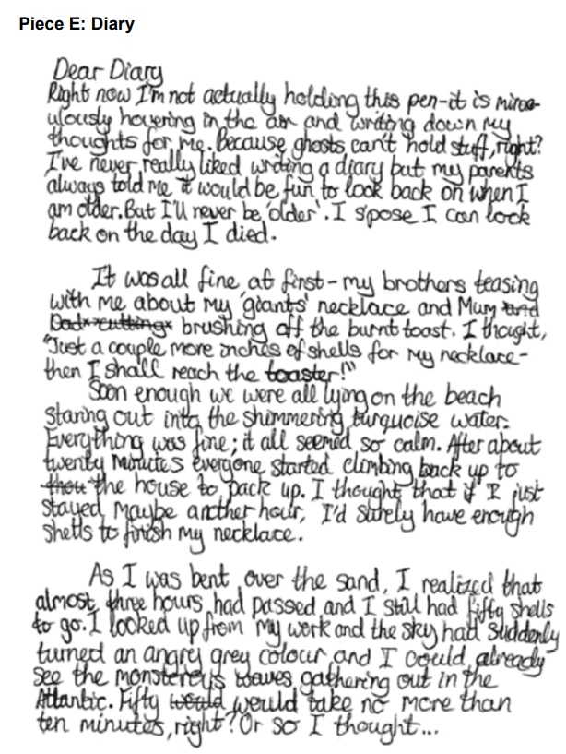
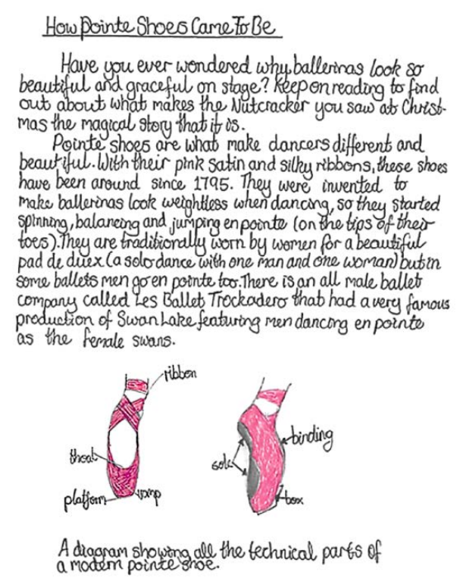
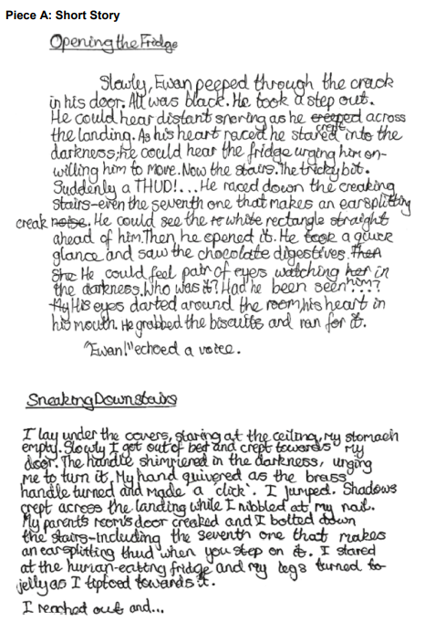
Greater Depth

Slide 24
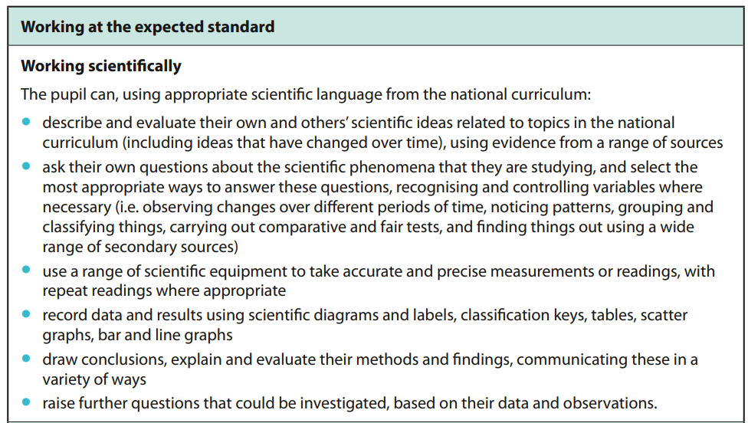


Y6 Science Expectations

Slide 25
How can YOU help?
Support homework completion – little and often!
Try to provide a quiet corner of the house for study, that’s as free from distractions as possible
Encourage your child to talk if they are feeling anxious. Practice using brain breaks, mindfulness and breathing techniques
Avoid using past papers – there are plenty of inexpensive or free SATs practice materials for parents available
Bring learning into everyday life - practise key skills like telling the time and mental maths in real world scenarios (shopping/cooking)
Help them to become resilient learners and embrace mistakes
Plan something restful or relaxing for the weekends

Slide 26

The BIG little things!
Early nights and lots of sleep
Good punctuality and attendance
Breakfast every day
A bottle of water in school
A morning snack
Lots of praise, encouragement and reassurance!

Slide 27
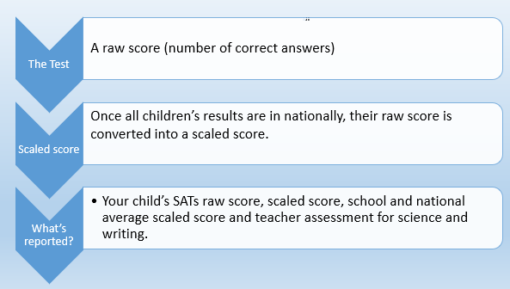

SATs - results explained!

Slide 28

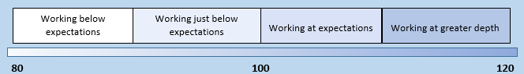
SATs - results explained!
Child C
Raw score 42/50
Standardised score of 114
110 or over is classed as
‘Greater Depth’
Child A
Raw score 17/50
Standardised score of 93
Has not yet met the expected standard
Child B
Raw score 26/50
Standardised score of 100
Met the expected standard
Meeting the expected standard indicates that the child is in a good academic position to access the KS3 curriculum as their KS2 curriculum knowledge and understanding is at a good standard.
Of course, some children will not meet the expected standard so we will endeavour to get them as close to this as possible as we will focus on their progress.
Notes:
The raw score that is decided as the expected standard is converted into a scaled score of 100. So 100 is technically a pass.
Meeting the expected standard indicates that the child is in a good academic position to access the KS3 curriculum as their KS2 curriculum knowledge and understanding is at a good standard.
Of course, some children will not meet the expected standard so we will endeavour to get them as close to this as possible as we will focus on their progress.

Slide 29
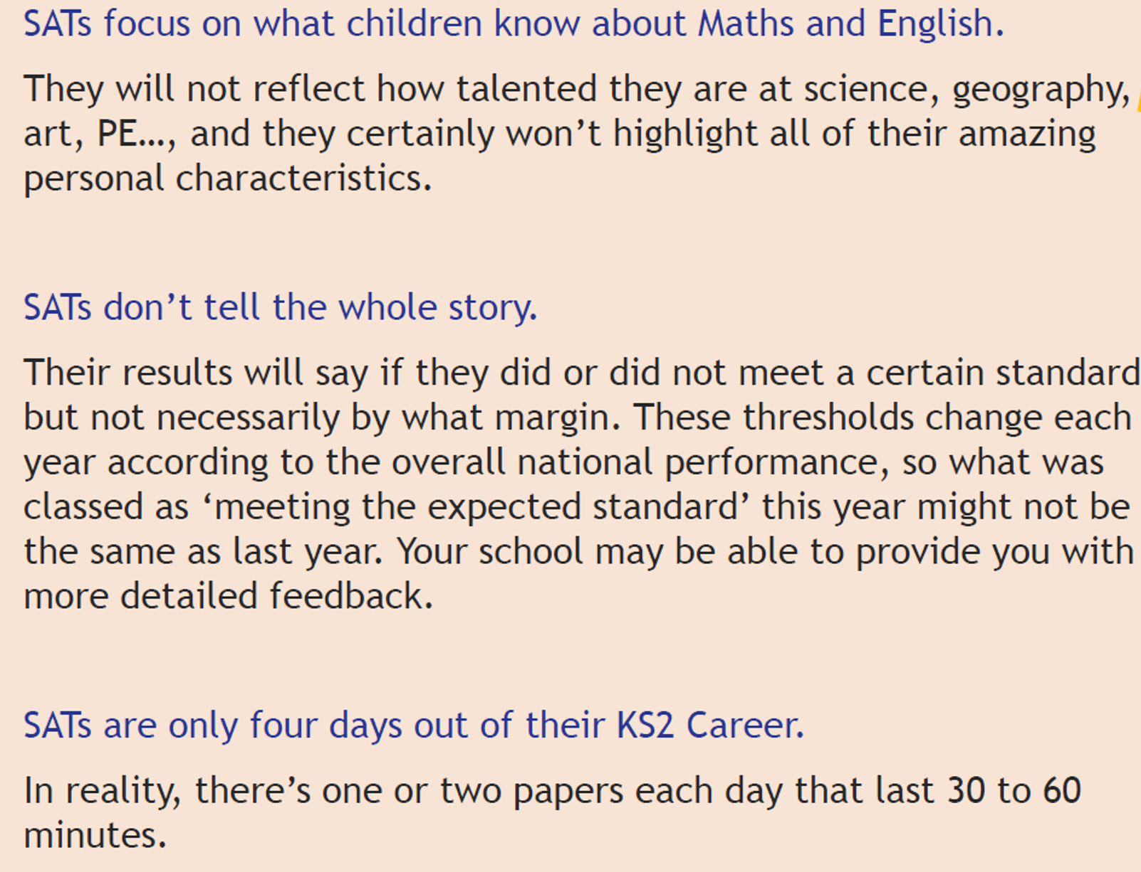

And remember…

Slide 30
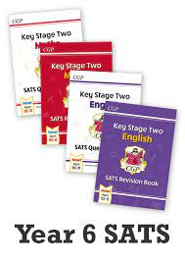

Useful resources
https://www.cgpbooks.co.uk/primary-books
CGP Workbooks and Revision Guides
https://www.bbc.co.uk/bitesize
BBC Bitesize KS2 – an excellent website for KS2. This covers all subjects through activities, videos and quizzes.
http://www.icteachers.co.uk/children/children_sats.htm
ICT Teachers - A wide range of KS2 SATs questions, from both past papers and their own team of teachers.

Slide 31

The Power of Reading
The skill of reading and understanding what we have read, are a huge part of everyday life.
Reading is key in all areas of the National Curriculum.
Creating a love of reading in children is potentially one of the most powerful ways of improving academic standards.

Slide 32


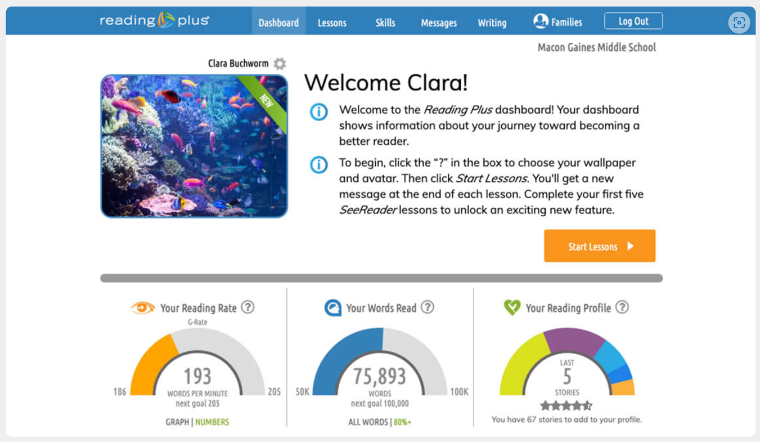
An online, interactive reading program.
Can be used at school and at home
Aims to build reading speed up to the 185 wpm required to complete the SATs reading paper
Improves fluency (automaticity) and comprehension skills, across all Y6 reading domains.
Sets additional skills practice, if required according to individual needs.

Slide 33
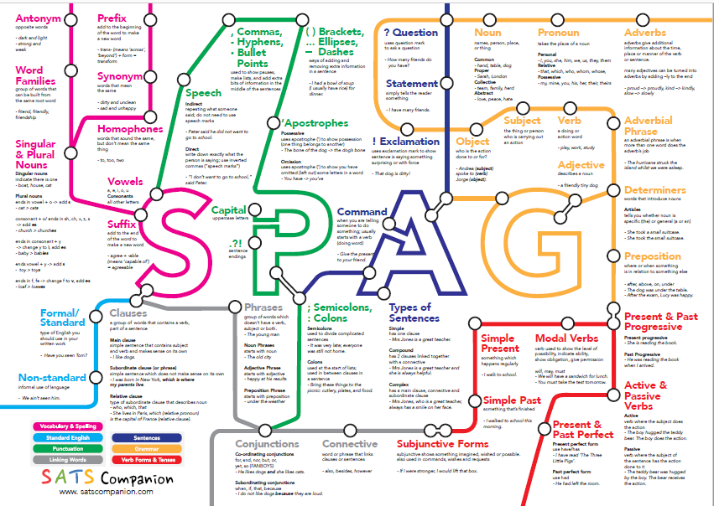

Slide 34



Use little and often to build speed with times tables facts and consolidate weekly learning.

Slide 35



Y6 to Y7 Transition
Takes place throughout Y6
Opportunity to attend Open Evenings
Taster Day in Summer Term at new school
Pupil handovers with Year 7 Heads and SENDCO
Extra transition and visits for SEND/SEMH pupils
Summer Holiday Camp places
Coping with change PSHE learning

Slide 36
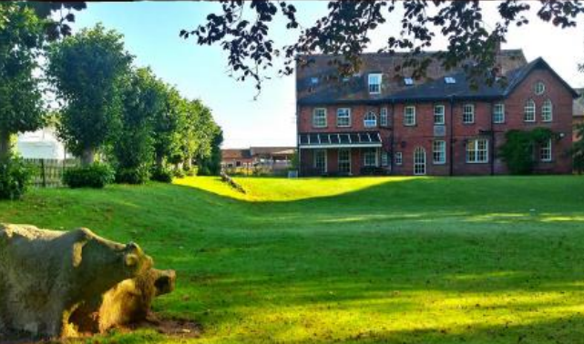
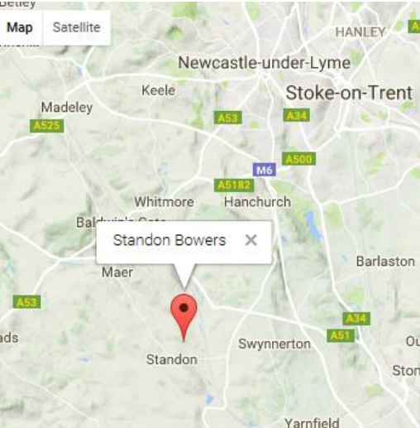

Y6 Residential
Residentials are a chance for children to experience time away from both school and home and taste a sense of adventure, in a safe, educational outdoor setting.

Slide 37
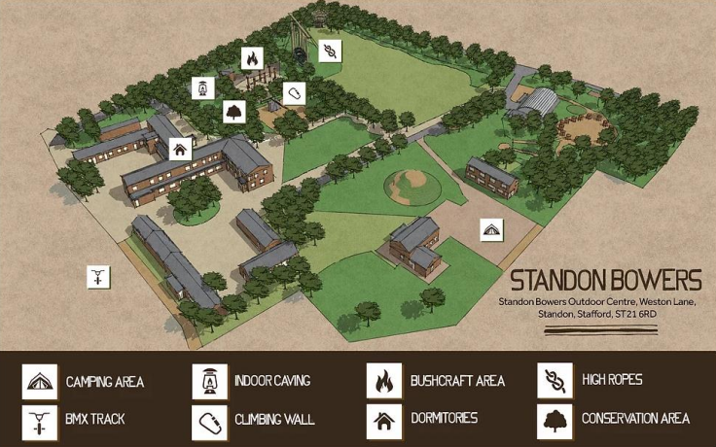
Site Map

Slide 38
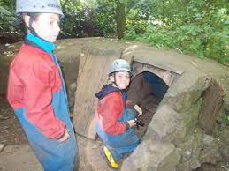
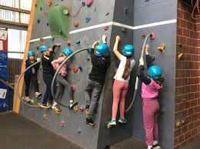
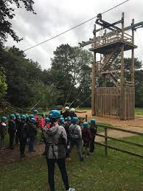

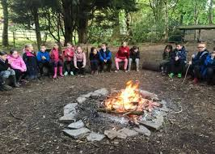
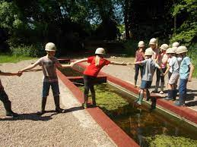

Activities

Slide 39

More information?
Please feel free to contact your child’s Y6 teachers should you have any questions. Email:
Claire Murfin cmurfin@thomasrussell-junior.staffs.sch.uk
Katie Rollins krollins@thomasrussell-junior.staffs.sch.uk
Lou Vardy lvardy@thomasrussell-junior.staffs.sch.uk
Thank you for your participation! ☺

